Slide 1
Lent Week 2

Slide 2
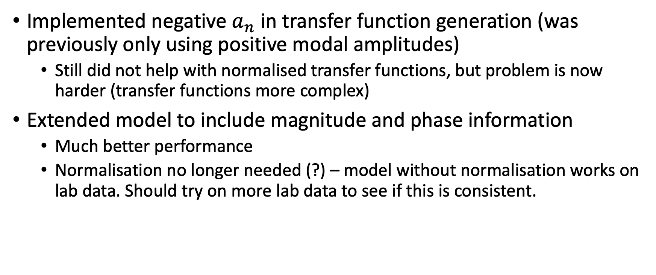
Changes
Implemented negative $a_{n}$ in transfer function generation (was previously only using positive modal amplitudes)
Still did not help with normalised transfer functions, but problem is now harder (transfer functions more complex)
Extended model to include magnitude and phase information
Much better performance
Normalisation no longer needed (?) – model without normalisation works on lab data. Should try on more lab data to see if this is consistent.

Slide 3
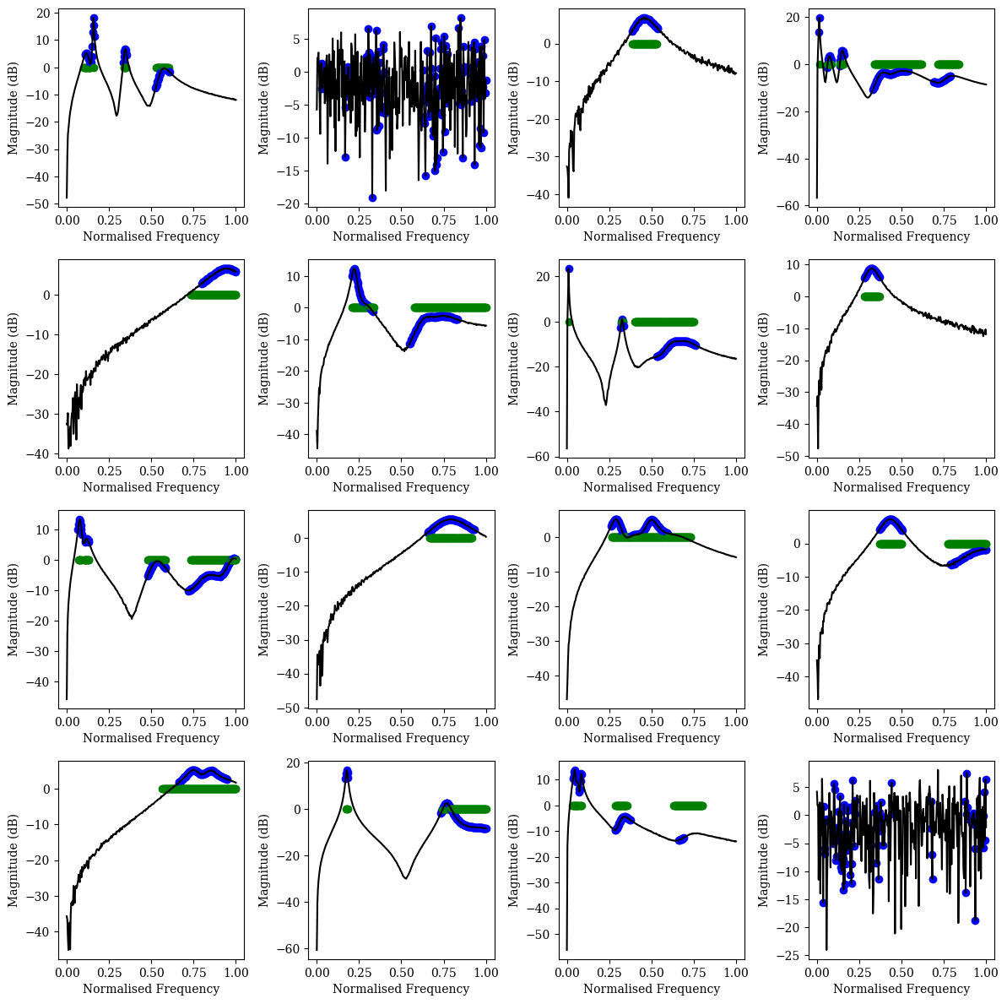
Previous performance on normalised TF (no phase and mag info passed to model)
Predicting modes in the noise

Slide 4
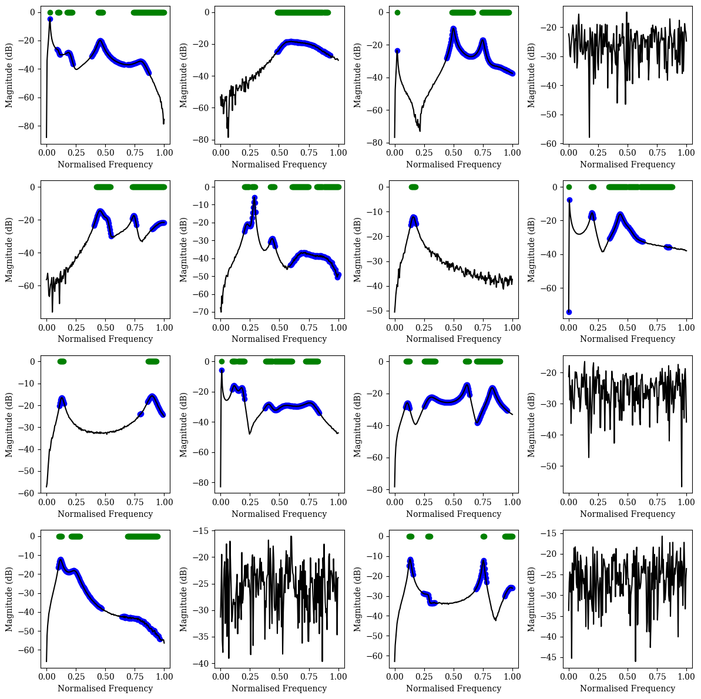
Predictions on normalised TF with phase and mag info
Overpredicting a bit but no longer predicting modes in the noise!

Slide 5
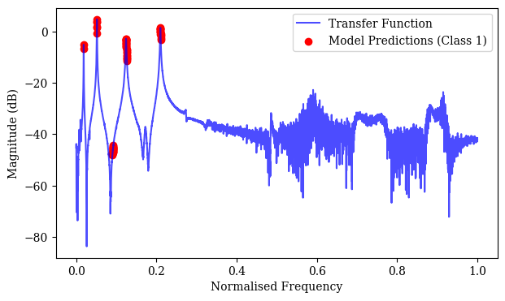
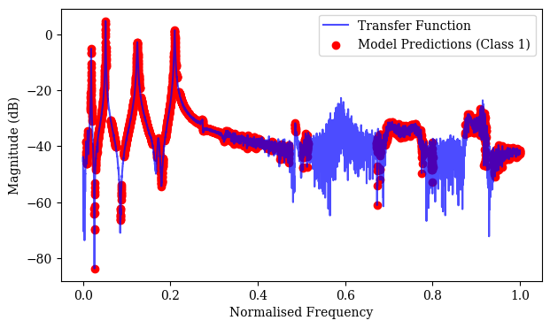
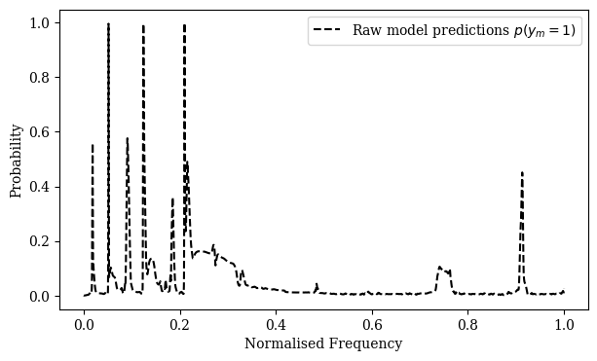
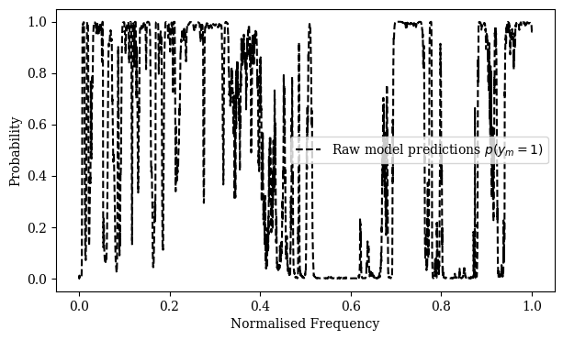
Lab Predictions without and with normalisation

Slide 6
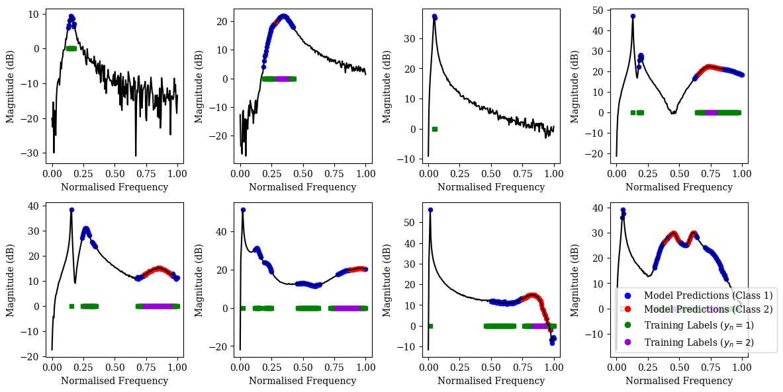
Multiclass Model (6 hours training, 14400 training examples) – working decently well

Slide 7
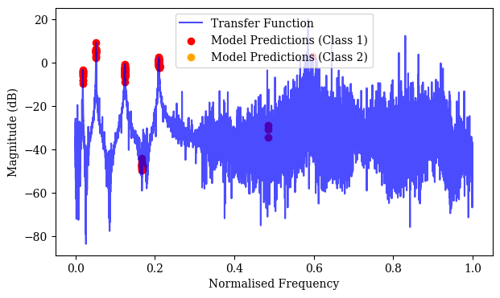
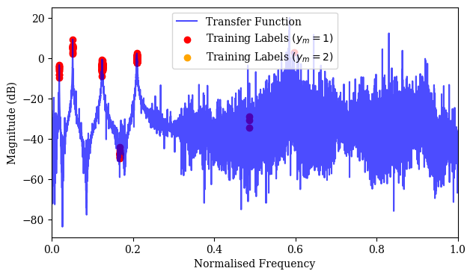
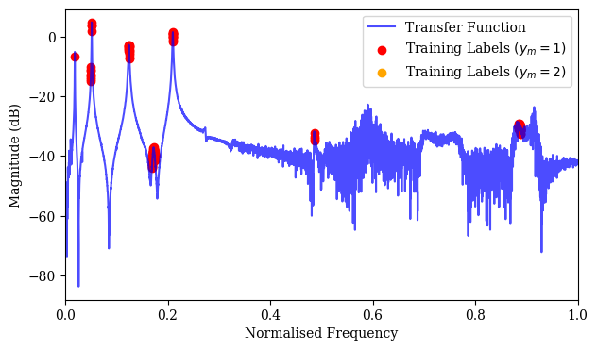
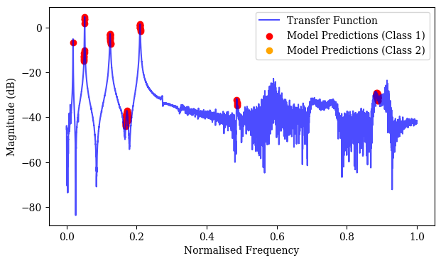
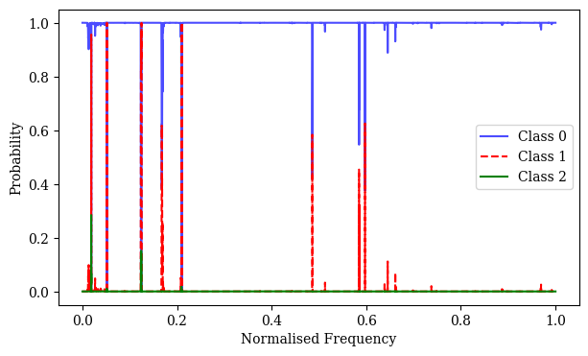
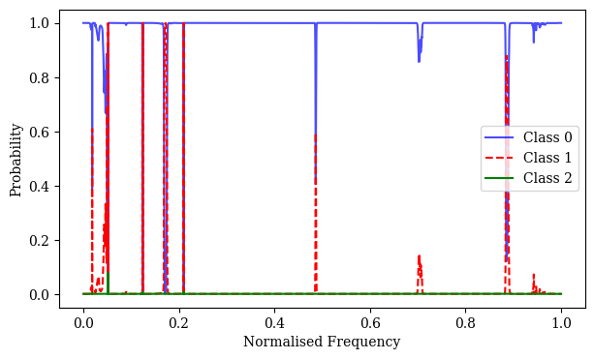
Lab Predictions with Multiclass Model (no normalization)

Slide 8
Next Steps
Bayesian inference

Slide 9
Notes
Val loss is less than training loss because of dropout !!
Included ‘extended’ as parameter in generate_data function, so no need to use generate_dat_extended
‘plot_predictions_extended’ function still needs to be used instead of ‘plot_predictions’ (combine these)
‘extend_lab_tf’ function extends the lab_tf (any tf) to include phase and magnitude information
Included ‘extended’ as parameter in lab_predictions function, so no need to use lab_predictions_extended. Also no need to pass extended_tf as additional parameter to this function.
Added ‘train_model_multiclass’ and ‘calculate_precision_and_recall’ for multiclass problem

